Slide 1
MIS 3301 Intro. to Business Programming Logic
Lists & Tuples
Part 3 – Sequence Operators & Functions; List Methods
Mrs. Nancy G. Sánchez

Slide 2
Outline
Part 2 – Sequence Operators & Functions, and List Methods
Sequence Operators & Functions – these work on all Range objects, Strings, Lists and Tuples
min(), max(), len()
Repetition, Concatenation - cannot do these on a range
in, not in
Slicing
List Methods – these work only with Lists
Adding values: append(), extend(), insert()
Finding values: index(), count() – these work with tuples too
Removing values: clear(), remove(), pop()
Changing the order: sort(), reverse()
Copying a list: copy()

Slide 3
Sequence Operators & Functions
The following are applicable to all sequences.
Sequence Operators & Functions – (i.e. Range, Strings, Lists and Tuples)
min(), max(), len()
Repetition, Concatenation - cannot do these on a range
in, not in
Slicing

Slide 4
min( ), max( ), len( )
ages = [33, 71, 22, 85, 18, 56]
min() – lowest value in a sequence
print('Lowest:', min(ages))
Lowest: 18
max() - highest value in a sequence
print('Highest:', max(ages))
Highest: 85
len() - # of elements in a sequence
print('Number of elements:', len(ages))
Number of elements: 6

Slide 5
Repetition & Concatenation
Does NOT Apply to Ranges!
Repetition operator
numbers = [0] * 5
[0, 0, 0, 0, 0]
quarters = ['Q1', 'Q2', 'Q3', 'Q4'] * 2
['Q1', 'Q2', 'Q3', 'Q4', 'Q1', 'Q2', 'Q3', 'Q4']
Concatenation operator
ages1 = [38, 33, 20, 27]
ages2 = [65, 55, 73, 81]
#Concatenate the lists
ages = ages1 + ages2
print('All ages:', ages)
All ages: [38, 33, 20, 27, 65, 55, 73, 81]

Slide 6
IN operator & NOT IN operator
depts = ['ISBA', 'MKT', 'FIN', 'MGT', 'ACC']
#Get search value
search_value = input('Enter a dept: ')
All of these examples return the same result…
Enter a dept: ISBA
ISBA found!
IN operator – storing the Boolean
Enter a dept: HIST
HIST not found!
#Determine if the value is in the list
is_found = search_value in depts:
if is_found:
print(search_value, 'found!')
else:
print(search_value, 'not found!')
NOT IN operator
#Determine if the value is NOT in the list
if search_value not in depts:
print(search_value, 'not found!')
else:
print(search_value, 'found!')
IN operator – directly in an IF
#Determine if the value is in the list
if search_value in depts:
print(search_value, 'found!')
else:
print(search_value, 'not found!')

Slide 7
SLICING Strings
A slice is a span of items that are taken from any sequence.
It works with STRINGs …
0
1
2
3
4
5
6
7
Slice syntax→ [start:end:step]
end is exclusive
Default values: start = 0, end = len(), step = 1
Note: When the slice operation is to the RIGHT of the =, the result is a new list.
name = 'John Doe'
With a start & end
my_str = name[5:7]
'Do'
5 through 6

Slide 8
SLICING Lists
A slice is a span of items that are taken from any sequence.
It works with LISTs …
0
1
2
3
4
depts = ['ISBA', 'MKT', 'FIN', 'MGT', 'ACC']
Slice syntax→ [start:end:step]
end is exclusive
Default values: start = 0, end = len(), step = 1
Note: When the slice operation is to the RIGHT of the =, the result is a new list.
-5
-4
-3
-2
-1
3 through 4
With a start & end
new_list = depts[3:5]
['MGT', 'ACC']
With a step value
new_list= depts[0:5:2]
['ISBA', 'FIN', 'ACC']
With variable names
a = 2
b = 5
new_list = depts[a:b]
['FIN', 'MGT', 'ACC']

Slide 9
SLICING Lists cont.
0
1
2
3
4
depts = ['ISBA', 'MKT', 'FIN', 'MGT', 'ACC']
-5
-4
-3
-2
-1
May omit values
new_list = depts[2:]
new_list = depts[:2]
new_list = depts[::2]
new_list = depts[:]
['FIN', 'MGT', 'ACC']
['ISBA', 'MKT']
['ISBA', 'FIN', 'ACC']
['ISBA', 'MKT', 'FIN', 'MGT', 'ACC']
Copy a List via slicing
May use a Negative value
Effect of mistakes
new_list = depts[-2:]
new_list = depts[:-2]
['MGT', 'ACC']
new_list = depts[3:50]
new_list = depts[3:2]
new_list = depts[3:3]
['MGT', 'ACC']
['ISBA', 'MKT', 'FIN']
[]
[]

Slide 10
SLICING Lists cont.
Does NOT Apply to Tuples!
0
1
2
3
4
depts = ['ISBA', 'MKT', 'FIN', 'MGT', 'ACC']
-5
-4
-3
-2
-1
Updating a slice with a new list of values
depts[0:2] = ['A', 'B']
['A', 'B', 'FIN', 'MGT', 'ACC']
Note: When the slice operation is to the LEFT of the =, then the slice in the list is updated (in place).
Since this is updating,
it does not apply to Tuples!
depts[0:2] = ['X', 'Y', 'Z']
['X', 'Y', 'Z', 'FIN', 'MGT', 'ACC']
It even works with extra values

Slide 11
List Methods
The following are applicable to Lists only.
List Methods
Adding values: append(), extend(), insert()
Finding values: index(), count() – these work with tuples too
Removing values: clear(), remove(), pop()
Changing the order: sort(), reverse()
Copying a list: copy()

Slide 12
Adding Values
depts = ['ISBA', 'MKT', 'FIN', 'MGT', 'ACC']
append() – increases the list by one element
#Add an item to the end
depts.append('EDU')
#Add a list to the end
a = ['x','y']
depts.append(a)
['ISBA', 'MKT', 'FIN', 'MGT', 'ACC', 'EDU']
List within a List
['ISBA', 'MKT', 'FIN', 'MGT', 'ACC', 'EDU', ['x', 'y']]
extend() – increases the list by the # of elements in the argument
#Add a list to the end
a = ['x','y']
depts.extend(a)
depts.extend('EDU')
This string has 3 elements.
[… 'E', 'D', 'U']
Argument must be an iterable: list, tuple, range, string,
['ISBA', 'MKT', 'FIN', 'MGT', 'ACC', 'x', 'y']
insert() – inserts an item at a specified position (not replacing)
#Add item in a specific position
depts.insert(3, 'ECO')
['ISBA', 'MKT', 'FIN', 'ECO', 'MGT', 'ACC']

Slide 13
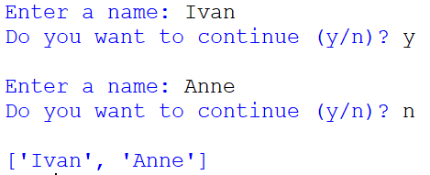
Adding Values via User Input
append() – increases the list by one element
names = []
cont = 'Y'
while cont.upper() == 'Y':
name = input('Enter a name: ')
names.append(name)
cont = input('Do you want to continue (y/n)? ')
print()
print(names)

Slide 14
Finding Values
Applies to Tuples too!
last_names = ['Jones', 'Doe', 'Lopez', 'Doe', 'Carey']
search_value = 'Doe'
['Jones', 'Doe', 'Lopez', 'Doe', 'Carey']
in operator – returns a Boolean denoting if the value exists
#Determine if the value is in the list
found = search_value in last_names
print('Is', search_value, 'in the list?:', found)
Is Doe in the list?: True
Does not crash when not found
index() – returns the index number of the 1st matching element
#Find the position of the 1st occurrence
pos = last_names.index(search_value)
print(search_value, 'found in position:', pos)
Crashes when not found!
Syntax: index(value, start, stop)
Solution: see the slide “Avoiding Exceptions”
Doe found in position: 1
count() – counts the number of matching elements
#Determine the number of occurrences
total = last_names.count(search_value)
print(search_value, 'occurs:', total, 'times')
Doe occurs: 2 times
Does not crash when not found

Slide 15
Removing Values
depts = ['ISBA', 'FIN', 'MKT', 'FIN', 'MGT', 'ACC']
clear() - clears all elements
#Remove all items
depts.clear()
print(depts)
[]
Does not crash with 0 elements.
remove() - removes 1st occurrence a specified value
#Remove one item
depts.remove('ACC')
print(depts)
Crashes when not found!
['ISBA', 'MKT', 'FIN', 'MGT', 'ACC']
Solution: see the slide “Avoiding Exceptions”
pop() - removes a specified element position
#Remove one item (i.e. specified pos)
depts.pop() #removes last element: ACC
last = depts.pop(2) #removes MKT
print(depts)
print('Last removed:', last)
Useful: pop() returns the value that was deleted!
Crashes when not found!
Solution: see the slide “Avoiding Exceptions”
['ISBA', 'FIN', 'FIN', 'MGT’]
Last removed: MKT

Slide 16
Avoiding Exceptions
Applies to Tuples too!
depts = ['ISBA', 'MKT', 'FIN', 'MGT', 'ACC']
Exceptions can occur with index(), remove(), and del when there is a missing value.
When the value is not found…
depts = ['ISBA', 'MKT', 'FIN', 'MGT', 'ACC']
pos = depts.index('AAA')
print('Value found in position:', pos)
Solution #1: First, test using the IN operator
Solution #2: use Exception Handling
depts = ['ISBA', 'MKT', 'FIN', 'MGT', 'ACC']
if 'AAA' in depts:
pos = depts.index('AAA')
print('Value found in position:', pos)
else:
print('Department name not found')
depts = ['ISBA', 'MKT', 'FIN', 'MGT', 'ACC']
try:
pos = depts.index('AAA')
print('Value found in position:', pos)
except ValueError:
print('Department name not found')
With pop(), the error is an IndexError
Department name not found
Department name not found

Slide 17
Changing the Order
sort() – sorts the list in place in either ascending/descending order
depts = ['ISBA', 'MKT', 'FIN', 'MGT', 'ACC']
#Sort ascending
depts.sort()
#Sort descending
depts.sort(reverse=True)
['ISBA', 'MKT', 'FIN', 'MGT', 'ACC']
['ACC', 'FIN', 'ISBA', 'MGT', 'MKT']
['MKT', 'MGT', 'ISBA', 'FIN', 'ACC']
We will cover the sorted() function later with “Advanced Sorting” which doesn’t change our original list.
Both methods works with numbers too!
reverse() – reverses the elements of a list in place
depts = ['ISBA', 'MKT', 'FIN', 'MGT', 'ACC']
#Reverse order
depts.reverse()
['ISBA', 'MKT', 'FIN', 'MGT', 'ACC']
['ACC', 'MGT', 'FIN', 'MKT', 'ISBA']

Slide 18
Copying a List
depts = ['ISBA', 'MKT', 'FIN', 'MGT', 'ACC']
Warning: same list!
#Same List
a = depts
a[0] = 'AAA'
print('DEPTS:', id(depts), depts)
print('a: ', id(a), a)
DEPTS: 3231061928960 ['AAA', 'MKT', 'FIN', 'MGT', 'ACC’]
a: 3231061928960 ['AAA', 'MKT', 'FIN', 'MGT', 'ACC']
copy() – create a new list w/ the same values
#Create a NEW List
a = depts.copy()
a[0] = 'AAA'
print('DEPTS:', id(depts), depts)
print('a: ', id(a), a)
DEPTS: 3231094734464 ['ISBA', 'MKT', 'FIN', 'MGT', 'ACC’]
a: 3231094752704 ['AAA', 'MKT', 'FIN', 'MGT', 'ACC']
Recall, can use Slicing to copy!
a = depts[:]

Slide 19
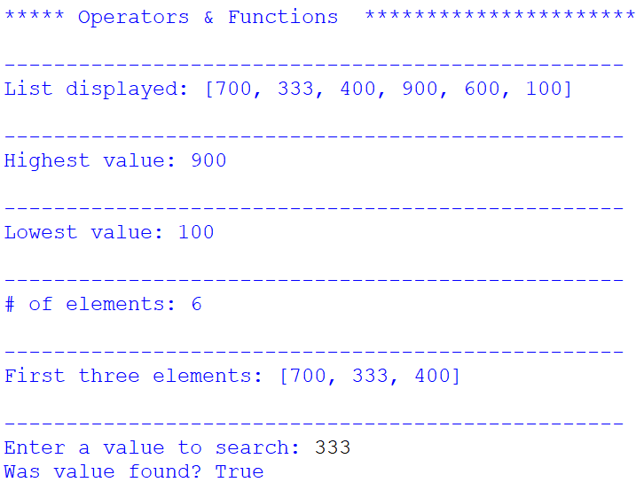
Exercise 5 – List Operators/Functions, Methods
Copy the starter code below and save it as Ch7-Ex05-List-Oper-Funct-Methods.py
#Ch7-Ex03-List-Oper-Funct-Methods.py
XXXX = '???'
#List
numbers = [700, 333, 400, 900, 600, 100]
#PART 1 - Practicing Sequence Operators & Functions--------------------------------
print('\n***** Operators & Functions ', '*'*50)
#Display the list
print('\n' + '-'*50)
print('List displayed:', XXXX)
#Display highest value
print('\n' + '-'*50)
print('Highest value:', XXXX)
#Display lowest value
print('\n' + '-'*50)
print('Lowest value:', XXXX)
#Display number of elements
print('\n' + '-'*50)
print('# of elements:', XXXX)
#Display first three elements
print('\n' + '-'*50)
print('First three elements:', XXXX)
###Display whether the number is found in the list
##print('\n' + '-'*50)
##search_value = int(input('Enter a value to search: '))
##found = XXXX
##print('Was value found?', found)
###PART 2 - Practicing List Methods-------------------------------------------------
##print('\n***** Practicing List Methods ', '*'*50)
##
###Find a value
##print('\n' + '-'*50)
##print('Display list:', numbers)
##search_value = int(input('\nEnter a value to search: '))
##print('Value found at pos:', XXXX)
##input('\n >> click to continue...')
##
###Sort the list ascending
##print('\n' + '-'*50)
##print('Before: ', numbers)
##XXXX
##print('After SORT:', numbers)
##input('\n >> click to continue...')
##
###Put list in reverse order
##print('\n' + '-'*50)
##print('Before: ', numbers)
##XXXX
##print('After REVERSE:', numbers)
##input('\n >> click to continue...')
##
###Delete a value
##print('\n' + '-'*50)
##print('Before:', numbers)
##delete_value = int(input('Enter a value to remove: '))
##XXXX
##print('List re-displayed:', numbers)
##input('\n >> click to continue...')
##
###Delete the last value (i.e. without user input)
##print('\n' + '-'*50)
##print('Before:', numbers)
##print('Last value auto-deleted:', XXXX)
##print('After:', numbers)
##input('\n >> click to continue...')
##
###Add a value to the end - don't use extend as the argument must be an iterable
##print('\n' + '-'*50)
##print('Before:', numbers)
##add_value = int(input('Enter a value to add at the end: '))
##XXXX
##print('After:', numbers)
Part 1
Replace all XXXX in the code to achieve what is stated in the comment lines (and as shown in the screenshot).
Use these Sequence Operators & Functions
min(), max(), len()
Repetition, Concatenation
in, not in
Slicing

Slide 20
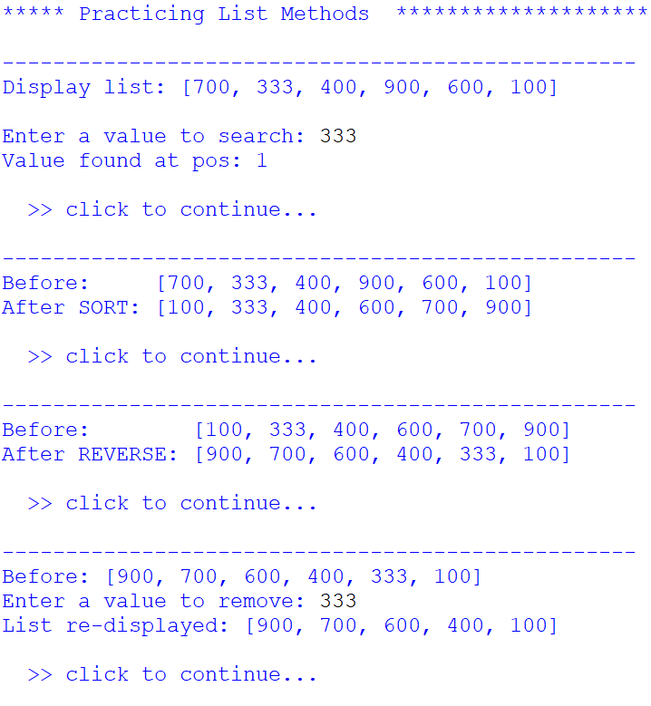
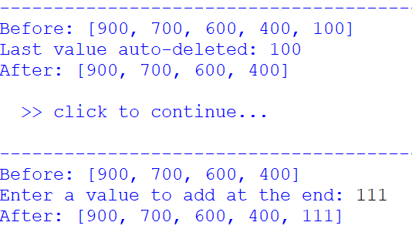
Exercise 5 cont.
Part 2
Replace all XXXX in the code to achieve what is stated in the comment lines (and as shown in the screenshot).
Use these List Methods
Adding values: append(), extend(), insert()
Finding values: index(), count()
Removing values: clear(), remove(), pop()
Changing the order: sort(), reverse()
Copying a list: copy()

